Slide 1

COMP 499/691: Conversational Artificial Intelligence
Transformers
Computer Science & Software Engineering
Concordia University, Winter 2024

Slide 2
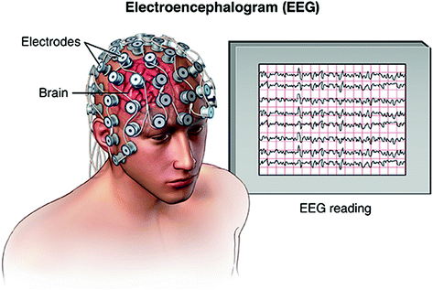

Seminar Announcement
Date | Room | Lecture topics
Feb., 16 9 am - 11 am | Remote | Introduction to EEG and EEG decoding
Feb., 23 9 am - 11 am | Remote | EEG Decoding with SpeechBrain
March, 15 9 am - 11 am | Remote | Decoding speech from the EEG
Dr. Davide Borra
University of Bologna
Connect at this zoom link:
https://concordia-ca.zoom.us/j/8734602220

Slide 3


Final Exam
The tentative date for the final exam is:
April, 24, 2024 19.00-22.00
Room: TBD

Slide 4

Project Proposals
The deadline for project proposals is
February, 16, 2024 at 23.59
(*) If you chose the instructor-proposed project, you do not need to submit a project proposal.

Slide 5

Online Lab Session
Just for this week, the lab session will be done online.
Topic: Lab 5 - Conversational AI
Time: Feb 15, 2024 06:00 PM Eastern Time (US and Canada)
Join Zoom Meeting
https://concordia-ca.zoom.us/j/82906850184?pwd=YkV1YWRlRzFIVFBzNnl5TGQxQnNWdz09
Meeting ID: 829 0685 0184
Passcode: 470915

Slide 6

Midterm Course Feedback
Your feedback is important to us!
We are (almost) in the middle of the course and we want to hear from you if everything is going well.
Please, fill out the anonymous form for midterm course evaluation available on Moodle.

Slide 7
Summary of the last episode….
What we have seen last time:
Recurrent Neural Networks
RNN-based Encoder-Decoder architecture
What we are going to learn today:
Transformers

Slide 8
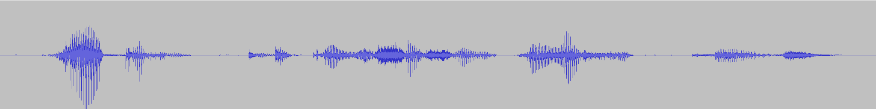
Sequence-to-Sequence Learning with RNNs
The goal of sequence-to-sequence learning is to map an input sequence with T elements into an output sequence with L elements.
Speech Recognition and Machine Translation are examples of seq2seq learning tasks:
Seq2Seq
Model
“J’”, “aime”, “les”, “chats”
For machine translation, the input is a sequence of embeddings (i.e, we typically assign a continuous vector to each input token)
“I”, “love”, “cats”
Seq2Seq
Model
“I”, “love”, “cats”
For speech recognition, the input is a sequence of features.
Features

Slide 9
Sequence-to-Sequence Learning
Encoder-Decoder architecture offers a natural way to address sequence-to-sequence learning
Input
Sequence
Encoder
Decoder
Output
Sequence
The encoder takes in input a sequence and turns it into a sequence of latent representations.
The decoder processes these latent representations to derive the output sequence.
RNN-based
Encoder-Decoder Models
Transformer-based

Slide 10
From Recurrent Neural Networks to Transformers

Slide 11
Seq2Seq Learning with RNNs
RNN encoders and decoders with attention results in a powerful architecture for seq2seq learning.
a1,1
“J”
“aime”
“les”
“chats”
<eos>
+
a1,2
a1,3
Softmax
Softmax
Softmax
Softmax
Softmax
Linear
Linear
Linear
Linear
Linear
RNN
RNN
RNN
RNN
z1
RNN
z2
RNN
z3
RNN
z4
RNN
h1
h2
h3
Emb
Emb
Emb
Emb
Emb
Emb
Emb
Emb
“I”
“Iove”
“cats”
<bos>
“J”
“aime”
“les”
“chats”
Attention
z1
So
f
tmax
a1,1
What is the main limitation?
h1
MLP
z1
h2
MLP
a1,2
z1
a1,2
h3
MLP

Slide 12



Seq2Seq Learning with RNNs
RNNs are inherently sequential: we must process the inputs one by one.
RNN
RNN
RNN
We can compute h2 only after h1
We can compute h3 only after h2
h1
h2
h3
……………..
Emb
Emb
Emb
“I”
“Iove”
“cats”
We cannot parallelize!
This is an important limitation as it hinders the full exploitation of modern GPU's massive parallelization capabilities.
How can we make the model parallelizable?

Slide 13




Seq2Seq Learning without RNNs
What about replacing the RNNs with MLPs?
Let’s start with the encoder…
MLP-based encoder
RNN-based encoder
h1
h2
h3
RNN
RNN
RNN
MLP
MLP
MLP
h1
h2
h3
Emb
Emb
Emb
Emb
Emb
Emb
“I”
“Iove”
“cats”
“I”
“Iove”
“cats”
We cannot process all time steps in parallel
We can process all time steps in parallel
We have a major issue!

Slide 14
Seq2Seq Learning without RNNs
What about replacing the RNNs with MLPs?
a1,1
“J”
“aime”
“les”
“chats”
<eos>
a1,2
+
a1,3
Softmax
Softmax
Softmax
Softmax
Softmax
h1
h2
h3
Linear
Linear
Linear
Linear
Linear
MLP
MLP
MLP
RNN
z1
RNN
z2
RNN
z3
RNN
z4
RNN
Emb
Emb
Emb
Emb
Emb
Emb
Emb
Emb
“I”
“Iove”
“cats”
<bos>
“J”
“aime”
“les”
“chats”
Without the RNN, each input is independent of the others.
We lose position information.
We make the decoder's life unnecessarily complex.
The decoder heavily relies on input positions to predict the output.
How can we fix this?

Slide 15
Seq2Seq Learning without RNNs
a1,1
“J”
“aime”
“les”
“chats”
<eos>
a1,2
+
a1,3
Softmax
Softmax
Softmax
Softmax
Softmax
h1
h2
h3
Linear
Linear
Linear
Linear
Linear
MLP
MLP
MLP
RNN
z1
RNN
z2
RNN
z3
RNN
z4
RNN
Emb
Emb
Emb
Emb
Emb
Emb
Emb
Emb
“I”
“Iove”
“cats”
<bos>
“J”
“aime”
“les”
“chats”
I love cats
We make the decoder's life unnecessarily complex.
We have the same encoded states for:
love I cats
cats love I
The decoder heavily relies on input positions to predict the output.
….
How can we fix this?

Slide 16
Seq2Seq Learning without RNNs
We need to inject positional information!
We have to inform the network about the position of each input with positional embeddings.
a1,1
“J”
“aime”
“les”
“chats”
<eos>
a1,2
+
a1,3
Softmax
Softmax
Softmax
Softmax
Softmax
h1
h2
h3
Linear
Linear
Linear
Linear
Linear
MLP
MLP
MLP
RNN
z1
RNN
z2
RNN
z3
RNN
z4
RNN
0
1
2
Emb
Emb
Emb
Emb
Emb
Emb
Emb
Emb
“I”
“Iove”
“cats”
<bos>
“J”
“aime”
“les”
“chats”
The simplest solution is to just use a counter (that we can concatenate with the input embeddings).
We can also normalize the counter by the length of the input sequence (see the tutorial of this week).

Slide 17
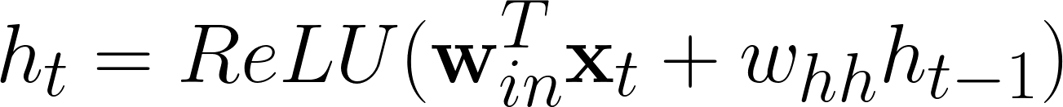
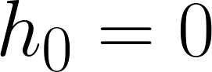
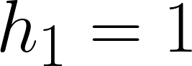
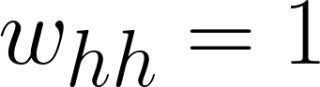
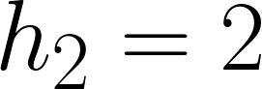
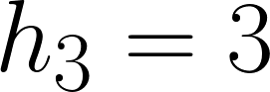
Seq2Seq Learning without RNNs
Why we do not need to inject positional information with RNNs?
Due to their sequential nature, RNNs can easily learn a counter.
RNN
RNN
RNN
h1
h2
h3
Let’s take, for simplicity, a single neuron of a vanilla RNN with ReLU activation:
Emb
Emb
Emb
“I”
“Iove”
“cats”
If the network sets:
Habemus Counter!

Slide 18

Seq2Seq Learning without RNNs
Can we replace RNNs from the decoder as well?
a1,1
“J”
“aime”
“les”
“chats”
<eos>
a1,2
+
a1,3
Softmax
Softmax
Softmax
Softmax
Softmax
h1
h2
h3
Linear
Linear
Linear
Linear
Linear
MLP
MLP
MLP
RNN
z1
RNN
z2
RNN
z3
RNN
z4
RNN
0
1
2
Emb
Emb
Emb
Emb
Emb
Emb
Emb
Emb
“I”
“Iove”
“cats”
<bos>
“J”
“aime”
“les”
“chats”
We just need to inject positional embeddings into the decoder as well.
This way, we know where we are at each decoding step. This makes decoding much easier!

Slide 19
Seq2Seq Learning without RNNs
Can we replace RNNs from the decoder as well?
a1,1
“J”
“aime”
<eos>
a1,2
+
a1,3
Softmax
Softmax
Softmax
h1
h2
h3
Linear
Linear
Linear
z1
z2
MLP
MLP
MLP
MLP
MLP
………….
MLP
0
1
2
0
1
4
Emb
Emb
Emb
Emb
Emb
Emb
“I”
“Iove”
“cats”
<bos>
“J”
“chats”
All the encoder representations can be computed in parallel.
After getting the encoder representation, all the decoder ones can be computed in parallel during training.
Why during training only?

Slide 20
Seq2Seq Learning without RNNs
a1,1
“J”
“aime”
<eos>
a1,2
+
a1,3
Softmax
Softmax
Softmax
h1
h2
h3
Linear
Linear
Linear
z1
z2
MLP
MLP
MLP
MLP
MLP
………….
MLP
0
1
2
0
1
4
Emb
Emb
Emb
Emb
Emb
Emb
“I”
“Iove”
“cats”
<bos>
“J”
“chats”
If the model is autoregressive, we have the labels to inject at the input of the decoder during training (teacher forcing)
At inference time, we have no labels and we need to process the elements one by one.
Non-autoregressive models can be fully parallelized both at training and inference time.

Slide 21

Seq2Seq Learning without RNNs
a1,1
“J”
“aime”
<eos>
a1,2
+
a1,2
Softmax
Softmax
Softmax
h1
h2
h3
Linear
Linear
Linear
z1
z2
MLP
MLP
MLP
MLP
MLP
………….
MLP
0
1
2
0
1
4
Emb
Emb
Emb
Emb
Emb
Emb
“I”
“Iove”
“cats”
<bos>
“J”
“chats”
Now, we have a model for Seq2Seq Learning without RNNs.
It is faster because it parallelizes much more!
This model does not work always very well in practice!
Transformers are an attempt to significantly improve this simple RNN-free architecture.

Slide 22
Transformers

Slide 23
Transformers
In the previous slides, we have seen a simple Seq2Seq Architecture without RNNs.
a1,1
“J”
“aime”
<eos>
a1,2
+
Softmax
Softmax
Softmax
h1
h2
h3
a1,3
Linear
Linear
Linear
MLP
MLP
MLP
MLP
MLP
………….
MLP
0
1
2
0
1
4
Emb
Emb
Emb
Emb
Emb
Emb
“I”
“Iove”
“cats”
<bos>
“J”
“chats”
Transformers improves it with:
1. Better positional encoding
2. Better attention mechanisms
3. Adding Layer Normalization
4. Adding Residual Connections

Slide 24

Transformers
This is the famous Transformer's architecture.
We can recognize some elements that are already familiar to us:
We have an encoder and a decoder.
2. We inject positional embeddings.
3. We use attention.
4. We have MLPs in both the encoder and decoder.
5. We use layer normalization.
6. We use residual connections.

Slide 25
Positional Embeddings

Slide 26
Positional Embeddings
In the previous RNN-free architecture, we added a counter to inject positional information.
However, this approach cannot generalize well to inputs of variable length.
For instance, consider an input sequence with a length bigger than the maximum one observed during training.
Transformers use a sinusoidal encoding scheme that can potentially generalize better.

Slide 27
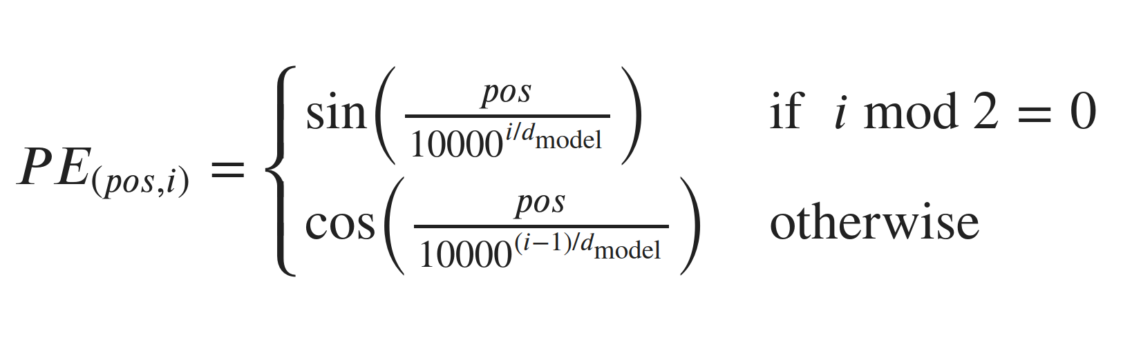

Positional Embeddings
There are many alternatives.
Transformers used positional sine and cosine functions of different frequencies:
PE(pos,i) contains the positional encoding at position pos in the sequence and hidden dimensionality i.
The positional encoding is not a single real number, but a vector of dmodel elements that encode the input position using sinusoids of different frequencies.

Slide 28
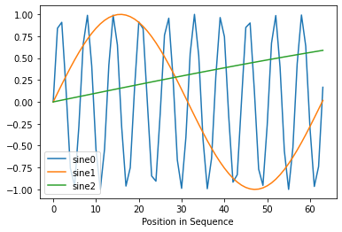
Positional Embeddings
Why multiple sinusoids of different frequencies?
If we jointly observe the values taken by different sinusoids, we can precisely retrieve the position of the corresponding element.

Slide 29


Positional Embeddings
Consider the following positional embeddings:
Sine0
Sine1
Sine2
Could you guess at which element in the sequence they correspond?
Sine0 is 0.6503
Many candidate positions can take this value: {2,4,7,9,13,15,19,21}
Sine1 is close to one.
This restricts the possible candidates to {15}
Sine2 is low (0.1494).
This confirms that the candidate is in position {15}

Slide 30

Positional Embeddings
For simplicity, we only use sines in the previous example.
Transformers use cosines as well.
More precisely, we use sines at even positions and cosines at odd positions.
From the original paper:
Why do we use both sines and cosines?
“We chose this function because we hypothesized it would allow the model to easily learn to attend by relative positions since for any fixed offset k, PE(pos+k, :) can be represented as a linear function of PE(pos,:).”
We can learn relative positioning between elements easily.

Slide 31
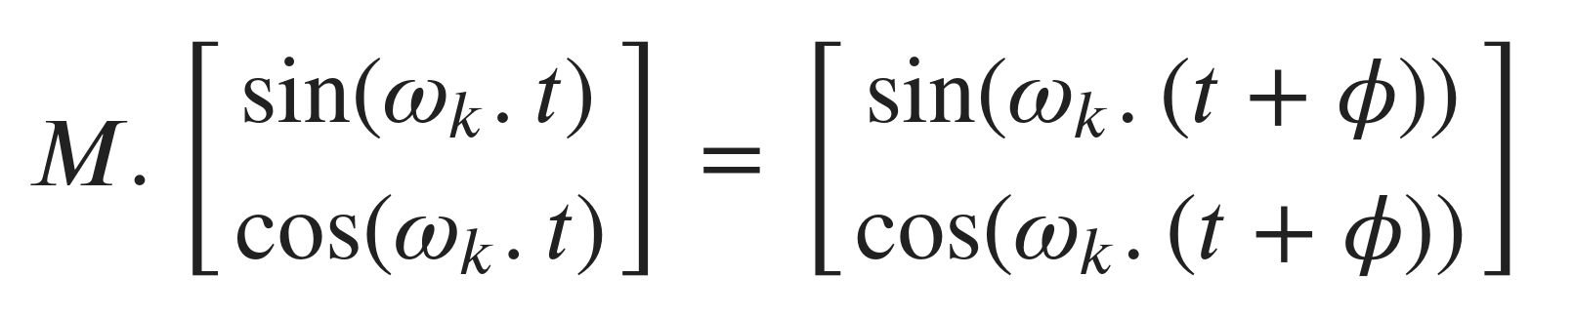
Positional Embeddings
Why do we use both sines and cosines?
To learn relative positioning between elements easily.
For every sine-cosine pair corresponding to frequency ωk, there is a linear transformation 𝑀 (independent of the current position t) where the following equation holds:
Relative “jump”
This feature implies that we can learn how to attend a different relative position (e.g., my current position t + 3) just by learning a linear transformation.

Slide 32
Positional Embeddings
Why sum up input and positional embeddings?
We sum up input embeddings and positional embeddings.
They both need to be of the same size dmodel
The new vector contains both information on the input’s content and its position.
Note that one alternative could have been concatenating the two embeddings.
The summation, however, works well in practice and does not increase the input dimensionality.

Slide 33
Positional Embeddings
In summary, sinusoidal positional embeddings are a very clever solution:
They can generalize to unseen positions much better than a simple counter.
They have the nice property of making it easier to attend to relative positions.

Slide 34
Scaled Dot Product Attention

Slide 35
Scaled Dot Product Attention
Attention is the key component of Transformers.
It is not by chance that the Transformer paper is entitled “Attention is all you need”.
We use two types of attention:
Self-attention allows the model to capture the relationships between the elements in the same sequence.
Cross-attention captures the relationships between the encoded and decoded elements.
We employ self-attention at both encoder and decoder

Slide 36
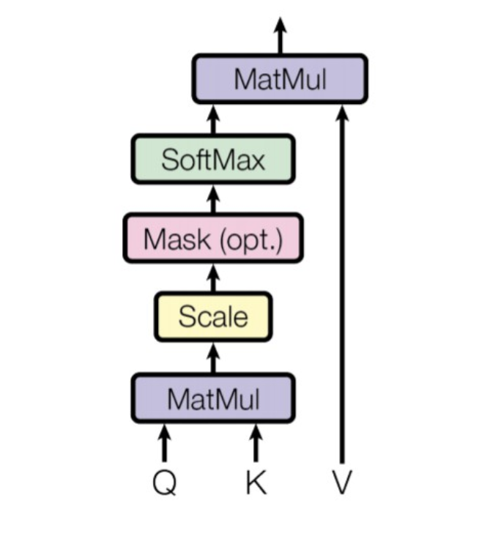
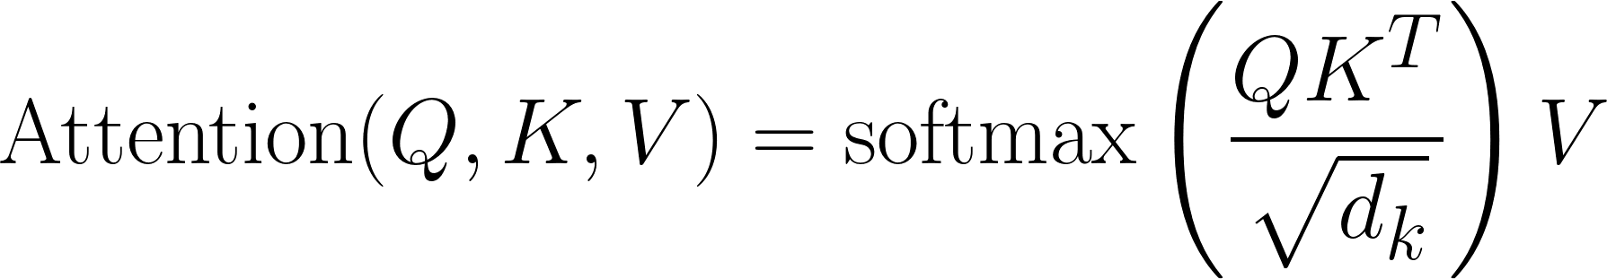
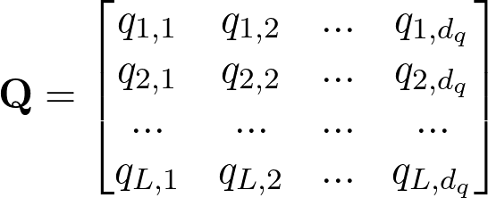
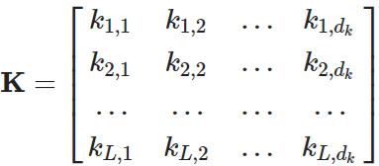
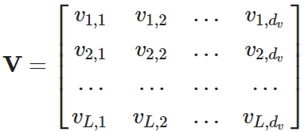
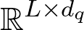
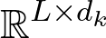
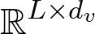
Scaled Dot Product Attention
The attention mechanism used in Transformers differs from the Bahdanau attention used so far.
We use Scaled Dot Product Attention:
For every time step, we have 3 vectors:
Queries
Keys
Values

Slide 37
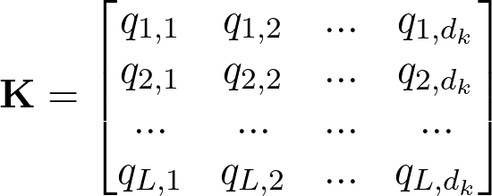
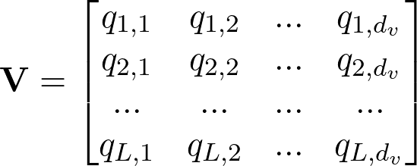
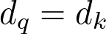
Scaled Dot Product Attention
The attention score between the element i and j in the sequence depends on the similarity of the query and key vectors.
……….
q1
k1
v1
q2
k2
v2
qL
kL
vL
The similarity is computed using the dot product.
l=1
l=2
l=L
To make the dot product feasible:
Queries
Keys
Values

Slide 38
Scaled Dot Product Attention
We have to compute the dot product between all the query and key pairs in the sequence
……….
q1
k1
v1
q2
k2
v2
qL
kL
vL
l=1
l=2
l=L
Queries
Keys
Values

Slide 39
Scaled Dot Product Attention
We have to compute the dot product between all the query and key pairs in the sequence
……….
q1
k1
v1
q2
k2
v2
qL
kL
vL
l=1
l=2
l=L
Queries
Keys
Values

Slide 40
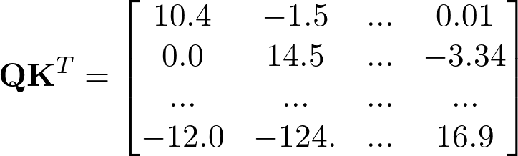
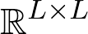
Scaled Dot Product Attention
We have to compute the dot product between all the query and key pairs in the sequence
……….
q1
k1
v1
q2
k2
v2
qL
kL
vL
l=1
l=2
l=L
The results is an L x L Matrix
Queries
Keys
Values
Dot Product
Low
similarity
High similarity

Slide 41
Scaled Dot Product Attention
Why do we need to scale the dot product?
The dot product is normalized to prevent the attention weights from becoming too large or small.
This scaling factor is crucial to maintain an appropriate variance of attention values.
Very low variance
Same attention weights for all the time steps.
Very high variance
Attention weights will be “1” for one element and “0” for all the others.

Slide 42
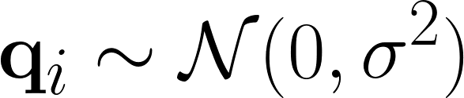
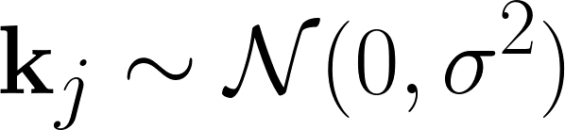
Scaled Dot Product Attention
What happens to the variance when we do the dot product?
Let’s consider the query q^{i} and the key k^{j}
q^{i}
q₁^{i}
q₂^{i}
q₃^{i}
…
q_{dk}^{i}
We assume the elements of the query and key vectors to be drawn from two independent Gaussian distributions
k^{j}
k₁^{j}
k₂^{j}
k₃^{j}
…
k_{dk}^{j}

Slide 43
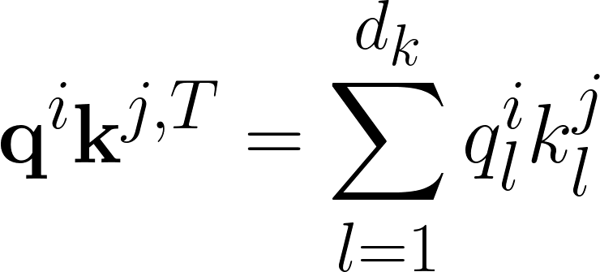


Scaled Dot Product Attention
What happens to the variance when we do the dot product?
q^{i}
q₁^{i}
q₂^{i}
q₃^{i}
…
q_{dk}^{i}
k^{j}
k₁^{j}
k₂^{j}
k₃^{j}
…
k_{dk}^{j}
if 𝑋 and 𝑌 are independent random variables:
Sum of random variables
Multiplication of random variables

Slide 44
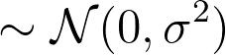
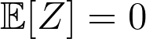

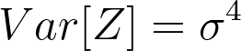
Scaled Dot Product Attention
What happens to the variance when we do the dot product?
Z
The product of two Gaussian random variables is not Gaussian anymore
Z is distributed as a linear combination of two Chi-square random variables

Slide 45
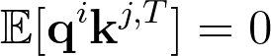
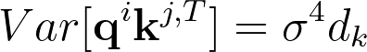
Scaled Dot Product Attention
What happens to the variance when we do the dot product?
Z

Slide 46

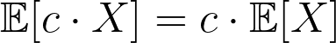
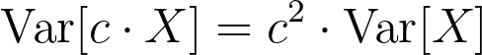
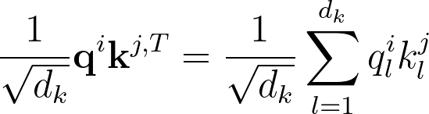
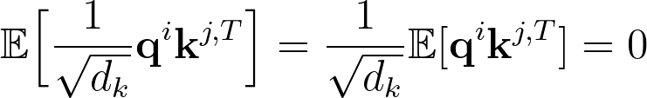
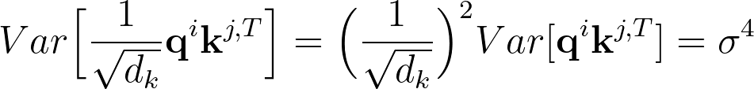
Scaled Dot Product Attention
What happens to the variance when we do the dot product?
dk can be a large number. We want the variance to not depend on it:

Slide 47
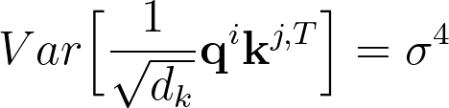
Scaled Dot Product Attention
What happens to the variance when we do the dot product?
After normalization, the variance does not depend anymore from dk
However, to avoid the variance increasing or decreasing too much this is not enough.
We have to make sure the variance of q^{i} and k^{j} is close to 1.
We initialize the parameters such that keys and query vectors have zero mean and a unitary variance.
To help with that:
We use layer normalization that generally helps to maintain the variance close to 1.
We can monitor the variance during training to make sure it does not deviate too much from 1

Slide 48
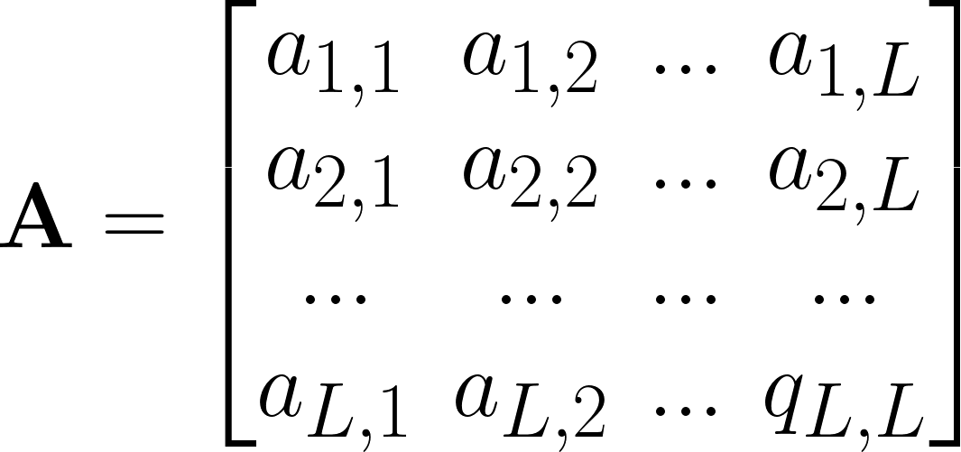
Scaled Dot Product Attention
After computing the normalized dot product, we compute the attention weights by applying a softmax.
Sum = 1
The softmax is applied over the column dimension.
Sum = 1
Each attention weight is a number between 0 and 1.
Sum = 1
Each column sums to 1.

Slide 49
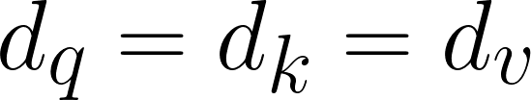
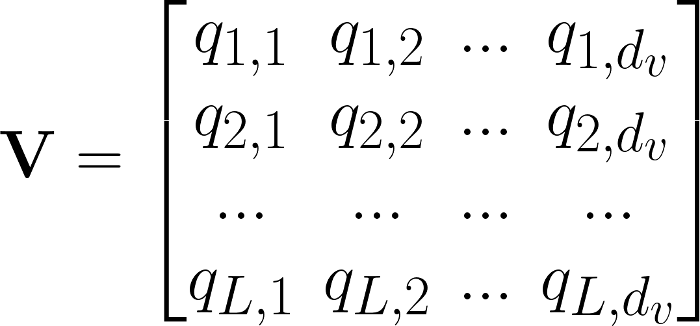
Scaled Dot Product Attention
Normally, we set:
(L x L)
(L x dv)
(L x dv)
The output of the attention block is a weighted sum of all the values.
dmodel

Slide 50

Scaled Dot Product Attention
The scaled dot product attention draws inspiration from a standard search scenario:
The query is the user’s request
“How to make a chocolate cake”
The keys are the indexed terms in all documents.
key1
key2
key3
“Book”
“Recipe”
“Best”
“Top10”
“Cake”
“Restaurant”
“2023”
“Chocolate”
“Montreal”
The value is the recipe found by the system.
Transformers works on “encoded” versions of queries, keys, and values, that only the neural network can internally understand.

Slide 51
Multi-Head Attention

Slide 52

Multi-Head Attention
An attention mechanism allows us to only attend to one specific aspect of the input sequence.
There might multiple different pieces of information in the sequence that we want to simultaneously attend.
We might have different attention heads, each one attending to a different aspect of the input:
Head 1: focuses on “Names”
Head 2: focuses on “Verbs”
Head 3: focuses on “Articles”
…..
What about running multiple attention mechanisms in parallel?

Slide 53
Multi-Head Attention
dmodel=40
To implement multi-head attention, we do the following steps:
Linear
dmodel=40
Reshape
1. Perform a linear transformation of the input.
2. Chunk the vector into subparts to represent values, keys, and queries.
num_heads=4
Dot Product Attention
3. Reshape the value, key, and query vectors to represent the multiple heads (dmodel must be divisible by num_heads).
num_heads=4
10
Reshape
4. Apply dot product attention to each head in parallel.
40
40
40
V
K
Q
Chunking
5. Reshape to concatenate the heads.
dmodel x 3 = 120
6. Apply a final linear transformation.
Linear
dmodel=40
Input

Slide 54
Other Components

Slide 55
Residual Connections
Why do we need residual connections?
Transformers are designed to be very deep.
The residual connections help with vanishing gradient issues.
Moreover, the positional embeddings are applied to the original input only.
Residual connections prevent them to be lost after the first attention layer.

Slide 56
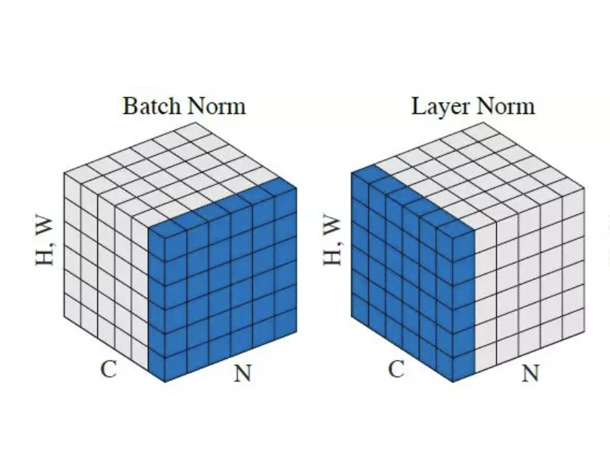
Layer Normalization
Why do we need layer normalization?
Layer Normalization plays an important role as well.
It enables faster training and provides regularization.
Additionally, it ensures that the internal representations have similar mean and variance.

Slide 57
Layer Normalization
Can we use batchnorm instead?
Yes, batchnorm can potentially be used.
However, batchnorm works well if the batch size is large.
Often, the batch size must be small in Transformers as they require a lot of GPU memory.
This is why we prefer layernorm.

Slide 58
Transformer Encoder
The encoder consists of N identical blocks.
Each block performs the following computations:
1. The input is first passed through a Multi-Head Attention block.
2. The output is added to the original input using a residual connection.
3. We apply layer normalization.
4. We process the normalized representations with a small MLP.

Slide 59

Transformer Encoder
Why do we use an MLP after the attention block?
The MLP adds capacity to the model.
With the MLP, the model can post-process the new information provided by the Multi-Head Attention.

Slide 60
Transformer Encoder
Note that dropout is also used.
dropout
Typically dropout is used right after attention and MLPs.
dropout
Dropout helps the network preventing overfitting.
It is used in the decoder as well.

Slide 61
Transformer Decoder
The architecture of the decoder is similar to the encoder.
One additional ingredient is the cross-attention layer.
Cross-attention allows us to relate encoding and decoding states.
The only difference with self-attention is that the queries come from the decoder and the keys from the encoder.

Slide 62
Transformer Decoder
The decoder is autoregressive.
The previous prediction is fed into the next decoding step.
During training, we can parallelize all the decoding steps anyway because we know the labels (teacher forcing).
Positional embeddings are injected at the decoding stage as well to inform the model about the current decoding step.

Slide 63


Transformer Decoder
We must mask the self-attention of the decoder.
The decoder is autoregressive.
We do not want the self-attention mechanism to attend to future decoded elements.
Without masking future elements, the model will “cheat” just by copying-and-paste the input given at the next decoding step.
Perfect Training Performance
Terrible Inference Performance

Slide 64
Transformer Decoder
We must mask the self-attention of the decoder.
How can we apply the mask?
To mask the future time steps, we just need to:
Set their dot product to -infinity.
or
2. Set their attention weights to zero.

Slide 65
Transformer Decoder
Often, we need to apply an additional mask (at both the encoder and decoder) to avoid attending zero-padded elements.
We don’t want to attend to these elements as they don’t carry valuable information.
00000000000000000000000
Minibatch
We need to exclude the zero-padded elements at both the encoder and decoder (with both self-attention and cross-attention).
0000000000000000000
Sequence Length

Slide 66
Transformers
Transformers work well and provide state-of-the-art performance in many sequence processing tasks.
What is their main issue?
Transformers parallelize the computations as much as possible.
The price to pay is that Transformers are very memory-demanding.

Slide 67
Quadratic Memory Bottleneck
In particular, the self-attention mechanism requires a dot product between every pair of inputs in the sequence.
The memory requirements scale quadratically with the sequence length!
This makes it challenging to process very long sequences (e.g., few thousand inputs) with current GPUs.

Slide 68
Quadratic Memory Bottleneck
Several extensions to standard Transformers have been proposed to alleviate the quadratic memory bottleneck:
Linformer
Reformer
Longformer
……

Slide 69

RNNs vs Transformers
Let’s summarize the advantages and disadvantages of RNNs and Transformers.
RNNs
Transformers
Sequential Processing
Parallel Processing
Transformers often provide better performance than RNNs
State-of-the-art performance in many tasks
Memory Efficient
Memory Demanding
Parameter Efficient
Often require more parameters than RNNs
Easier to make the model converge
Harder to make the model converge

Slide 70


Lab Session
During the weekly lab session, we will do:
Tutorial on Seq2Seq Learning with Transformers
Seq2Seq Learning with Transformers
Deadline: Feb, 20 11.59 pm

